Slide 1
OPERATING SYSTEM ARCHITECTURE
- Tephaune Frazer

Slide 2
TYPES OF SOFTWARE
APPLICATION SOFTWARE
Application software consists of the programs for performing tasks particular to the machine’s utilization
Examples: Spreadsheets, database systems, program development software, and games
SYSTEM SOFTWARE
System software performs tasks that are common to computer systems in general
Examples: Operating systems, device drivers, and utility software

Slide 3
COMPONENTS OF AN OPERATING SYSTEM
USER INTERFACE
The part of the operating system that communicates with the user
Older user interfaces, called shells, communicated with users through textual messages using a keyboard and monitor screen
While modern systems communicate using a graphical user interface (GUI)
KERNEL
The kernel directly interacts with the hardware and software of a computer, and acts as a bridge between the two when it comes to communication
The kernel takes care of tasks like process management, file system management, memory allocation, and system security

Slide 4
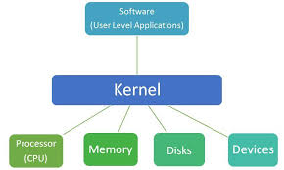
KERNEL - CONT.
The kernel manages all files using:
Directories
Directory Paths
Folders
The kernel also uses device drivers to communicate with peripheral devices so they can work fluently with the machine to perform their intended tasks.
- These peripheral devices include printers, keyboards, and monitors.
- Another component of the kernel is the memory manager.
It may create the illusion that the machine has more memory than it actually does (virtual memory) by playing a “shell game” in which blocks of data (pages) are shifted back and forth between main memory and mass storage (paging)

Slide 5
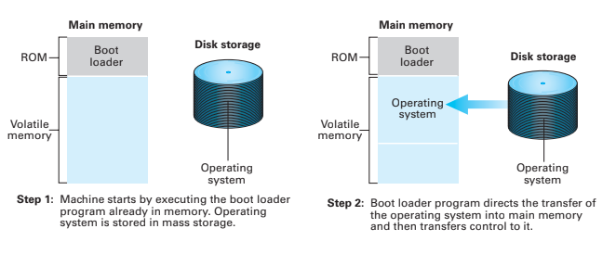
THE BOOTING PROCESS
Bootstrapping (or booting), is what occurs each time the computer turn on
It is the procedure that transfers the operating system from mass storage (where it is permanently stored) into main memory (which is essentially empty when the machine is first turned on)
The boot loader is permanently stored in the computer’s ROM, and instructs the CPU to run the operating system

Slide 6

THANKS

